Slide 1

Advancing Organic Photovoltaics with Infrastructure for Transferable, Reproducible, Useable, and Extensible (TRUE) Multiscale Models
September 22, 2020
Jenny W. Fothergill

Slide 2
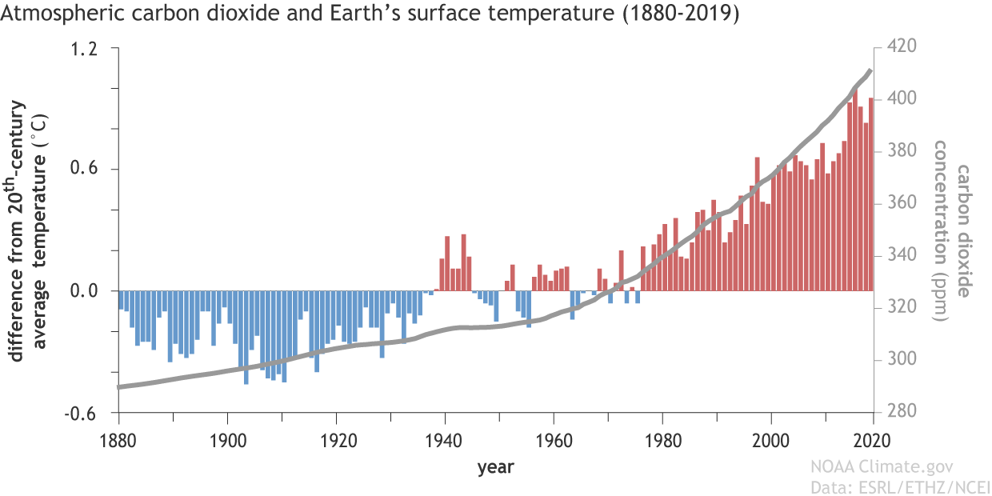
Global temperature rise is linked to atmospheric CO₂
Notes:
National Oceanic and Atmospheric Administration
Correlation
World is on fire

Slide 3
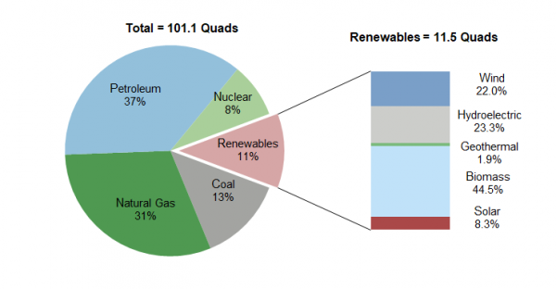
Solar accounts for less than 1% of US energy
Notes:
biggest producer of atmospheric co2 is fossil fuel consumption for energy
U.S. Energy Information Administration 2019

Slide 4
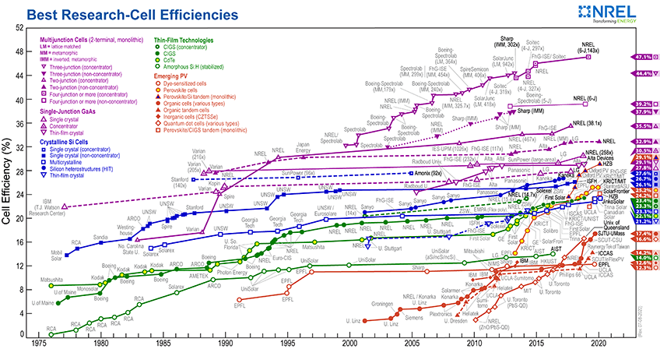
OPVs have potential to improve
Notes:
Shockley–Queisser limit is the maximum theoretical efficiency of a solar cell using a single p-n junction where the only loss mechanism is radiative recombination. 1961, maximum efficiency of 30% at 1.1 eV. This first calculation used the 6000K black-body spectrum as an approximation to the solar spectrum.

Slide 5
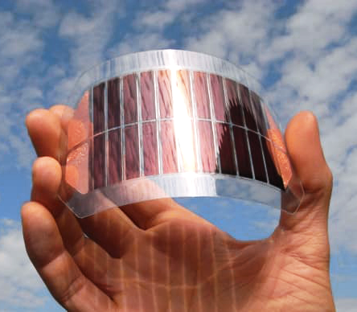
OPV production is
large scale and cheap
Notes:
Transition -> Efficiency/structure

Slide 6
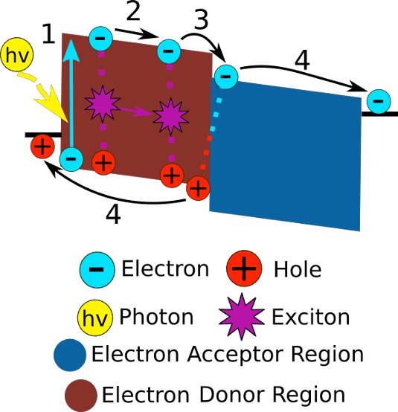

OPV efficiency is strongly linked to structure
Notes:
Transition -> morphology is governed by processing and chemistry

Slide 7
Welcome to the “ZOO”
Notes:
Transition - > combinatoric explosion, this is where simulation comes in

Slide 8
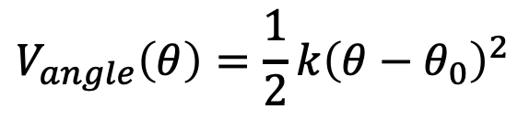
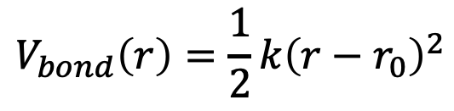
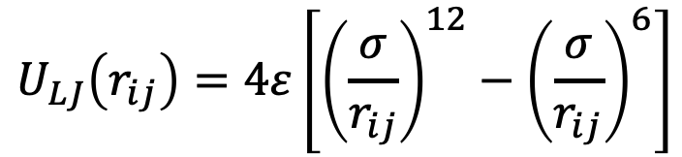
Molecular Dynamics
$$U_{LJ}\left(r_{ij}\right)=4ε\left[{\left(\frac{σ}{r_{ij}}\right)}^{12}−{\left(\frac{σ}{r_{ij}}\right)}^{6}\right]$$
$$V_{bond}\left(r\right)=\frac{1}{2}k{\left(r−r_{0}\right)}^{2}$$
$$V_{angle}\left(θ\right)=\frac{1}{2}k{\left(θ−θ_{0}\right)}^{2}$$
$$V_{dihedral}\left(φ\right)=\frac{1}{2}k_{1}\left(1−\cos{(φ)}⁡\right)+\frac{1}{2}k_{2}\left(1−\cos{(2φ)}⁡\right)+\frac{1}{2}k_{3}\left(1−\cos{(3φ)}⁡\right)+{\frac{1}{2}k}_{4}\left(1−\cos{(4φ)}⁡\right)$$
Notes:
Transition -> If I mix these two things together--what structure do they make?
Classical forces, Newtons equations of motion, sample thermodynamic ensemble
Right technique for this problem—right length scale (QCC), kinetics/polymers (MC)
Nvt canonical ensemble
Force field, potential energy
Update particle positions – get equilibrated morphology

Slide 9
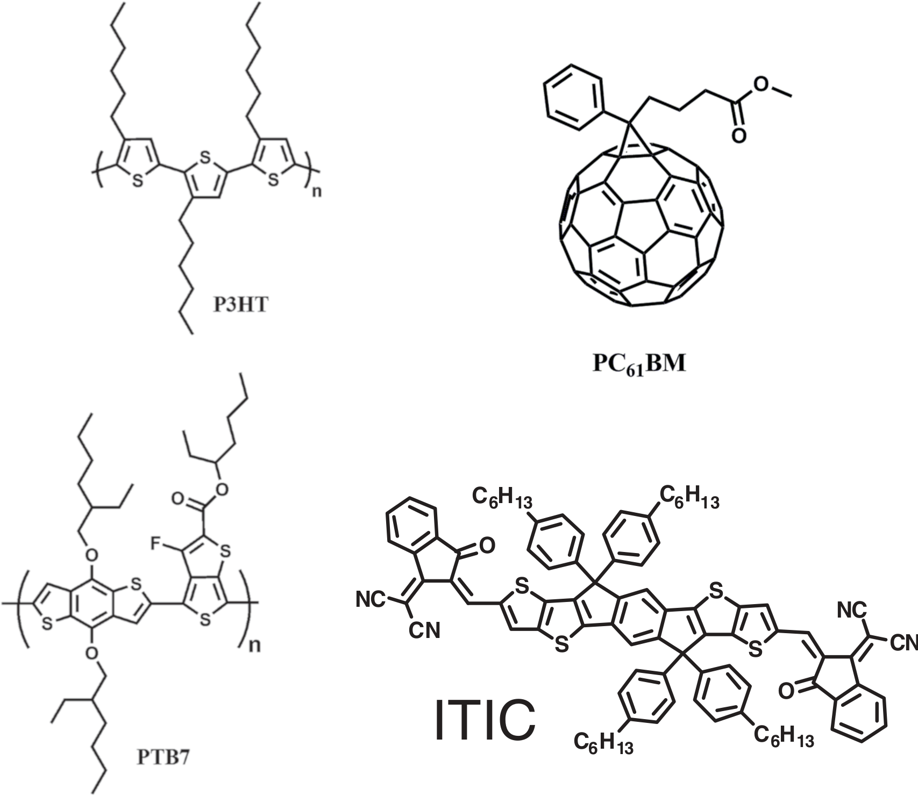
Choose chemistry
Create coarse-grain model
Obtain coarse-grain morphology
Backmap to retrieve atomic information
Calculate charge transport
Notes:
Transition -> Polymers require long length scales
Exciton dissociation length 5-10nm
C-c bond is 1.5 A (0.15 nm)
Diameter of a fullerene ~ 1nm

Slide 10
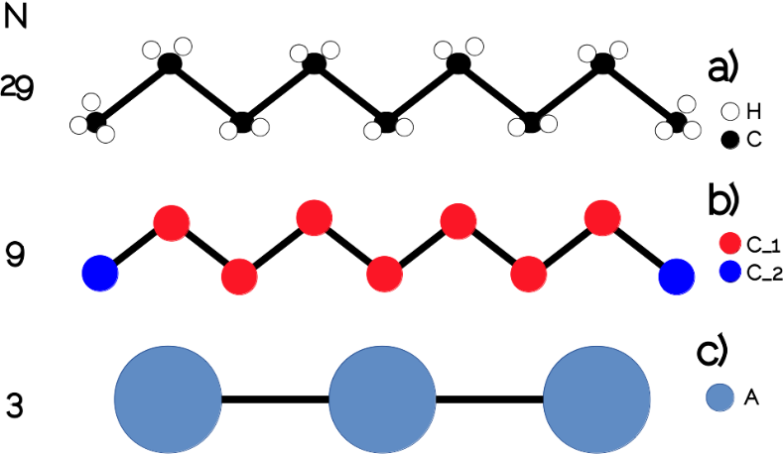
The mapping operator
Notes:
Transition -> but in order to simulate these, we need an effective force field

Slide 11
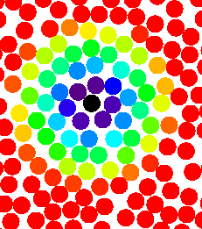
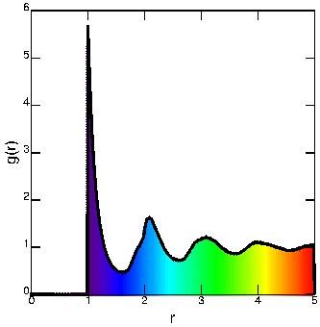
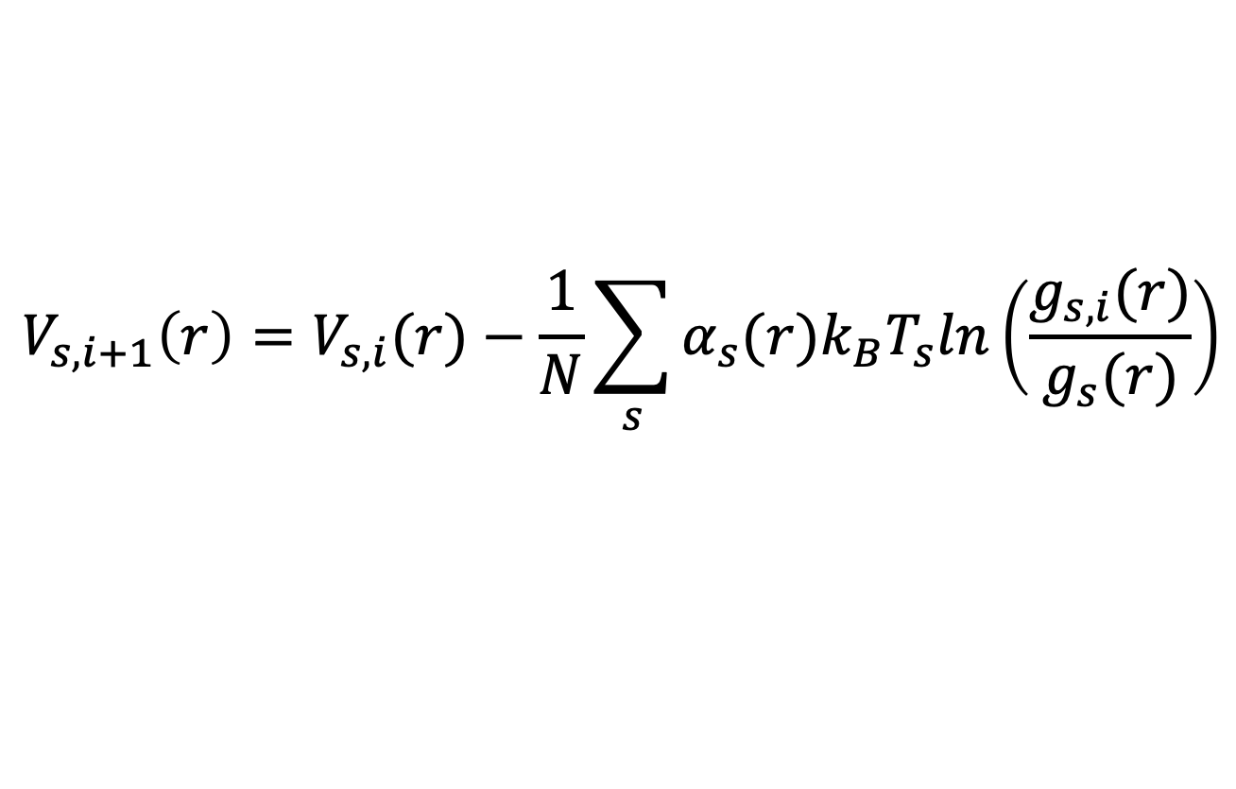
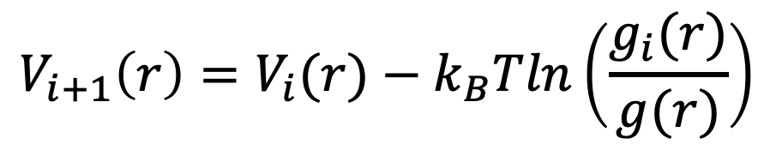
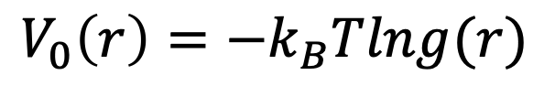
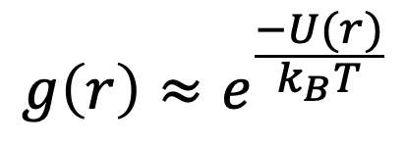
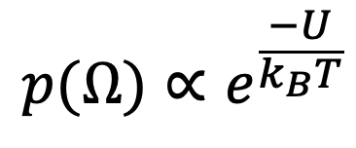
Iterative Boltzmann Inversion
$$p(Ω)∝e^{\frac{−U}{k_{B}T}}$$
$$V_{0}\left(r\right)=−k_{B}Tlng(r)$$
$$g\left(r\right)≈e^{\frac{−U(r)}{k_{B}T}}$$
$$V_{i+1}\left(r\right)=V_{i}(r)−k_{B}Tln\left(\frac{g_{i}(r)}{g(r)}\right)$$
$$V_{s,i+1}\left(r\right)=V_{s,i}(r)−\frac{1}{N}\sum_{s}{α_{s}(r)k_{B}T_{s}ln\left(\frac{g_{s,i}(r)}{g_{s}(r)}\right)}$$
Notes:
tune a potential to match a target distribution
starts with a equilibrate atomistic trajectory
the probability of observing a microstate is proportional to exp(-U/kT), where U is the energy of the microstate
and that's what g(r) is: A normalized probability of finding two particles separated by r
so, g(r) = exp(-U(r)/kT) -> -kT*ln(g(r)) = U(r)
This only works in a dilute system BUT it’s a good initial

Slide 12
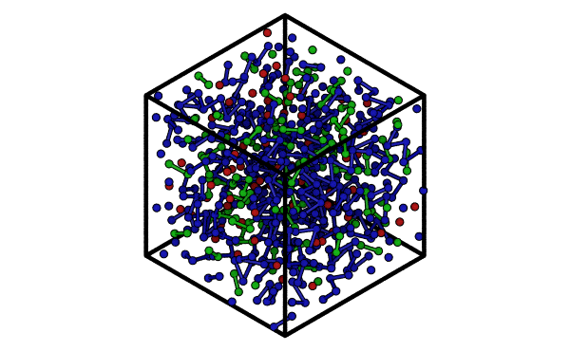
Choose chemistry
Create coarse-grain model
Obtain coarse-grain morphology
Backmap to retrieve atomic information
Calculate charge transport

Slide 13
Backmapping

Slide 14
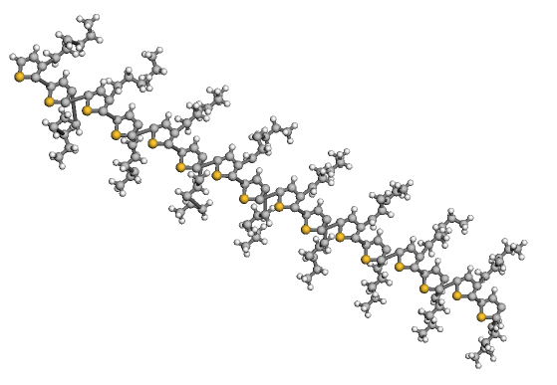
Choose chemistry
Create coarse-grain model
Obtain coarse-grain morphology
Backmap to retrieve atomic information
Calculate charge transport

Slide 15
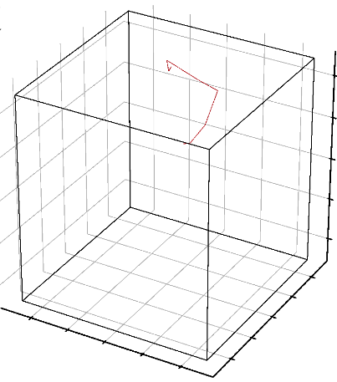

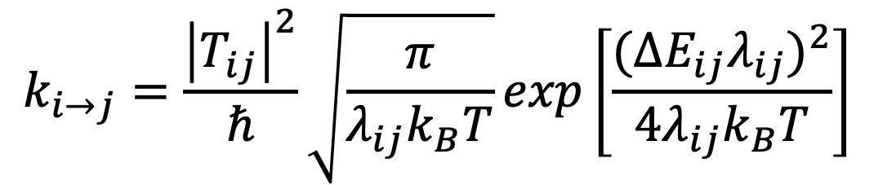
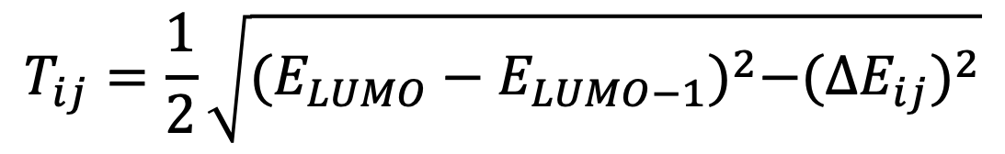
Choose chemistry
Create coarse-grain model
Obtain coarse-grain morphology
Backmap to retrieve atomic information
Calculate charge transport
$$k_{i→j}=\frac{{\left|T_{ij}\right|}^{2}}{ℏ}\sqrt{\frac{π}{λ_{ij}k_{B}T}}exp\left[\frac{{({∆E}_{ij}λ_{ij})}^{2}}{4λ_{ij}k_{B}T}\right]$$
$$T_{ij}=\frac{1}{2}\sqrt{{(E_{LUMO}−E_{LUMO−1})}^{2}−({{∆E}_{ij})}^{2}}$$
Notes:
Tij – transfer integral
Lambda – reorganization energy
Marcus hopping rate
Elumo-Elumo-1 – energy splitting
deltaEij is the difference between initial and final states
Transition → that’s the overview (what) now specific objectives

Slide 16
Objective 1: Develop a generalized toolset for coarse-graining and performing simulations of novel molecules for organic photovoltaics
Objective 2: Develop a general tool to calculate atomistic positions from a coarse-grained morphology
Objective 3: Predict nanostructures of novel OPV chemistries
Objective 4: Identify chemical features correlated with robust self-assembly
Objective 5: Identify chemical and morphological features correlated with good charge transport
Notes:
transition: but this isn't new, let’s talk a little bit about how I got here and my approach

Slide 17
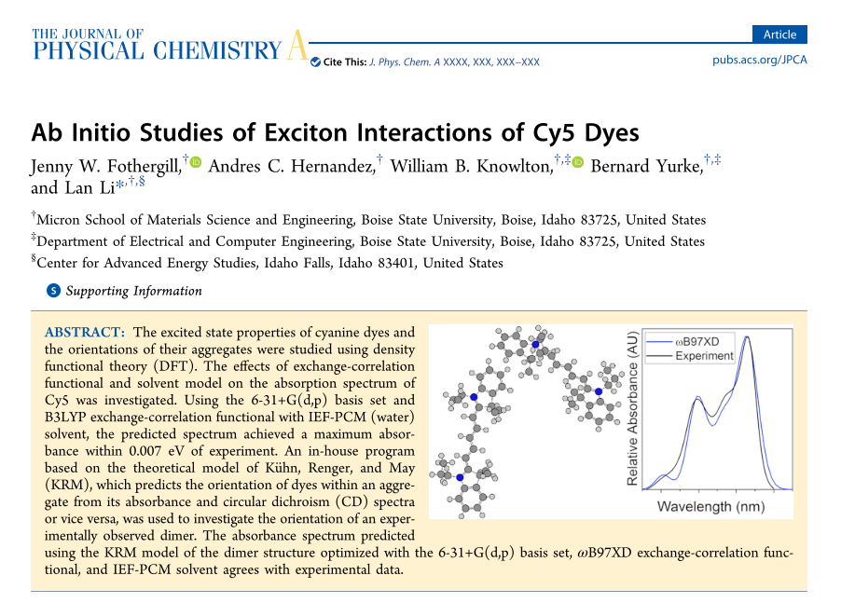
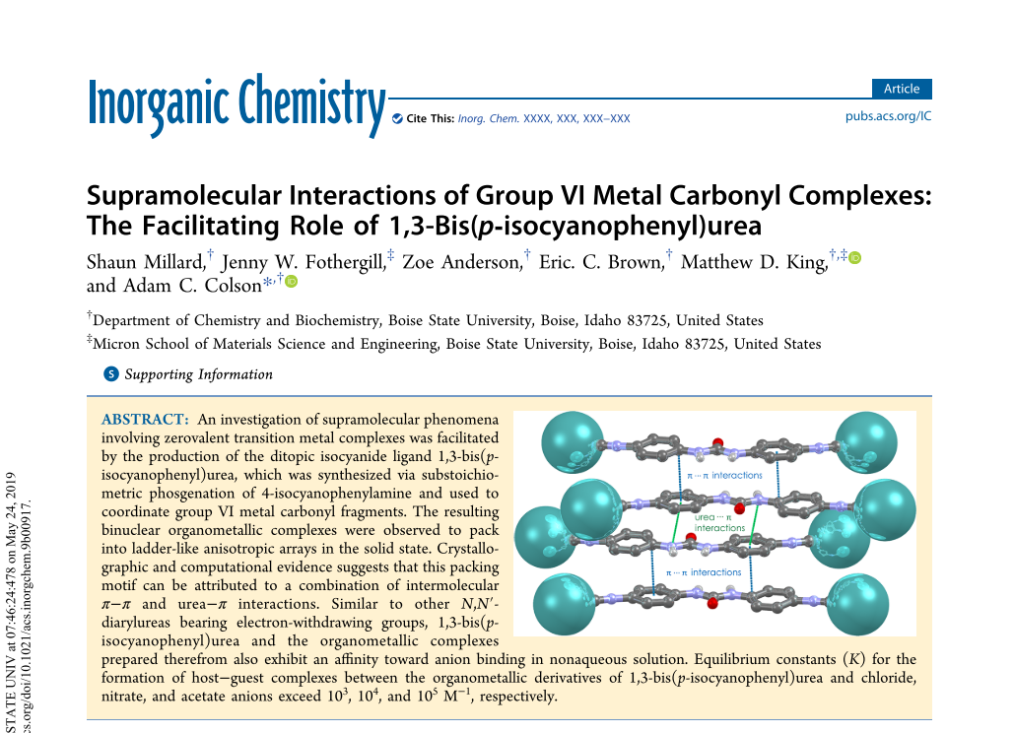
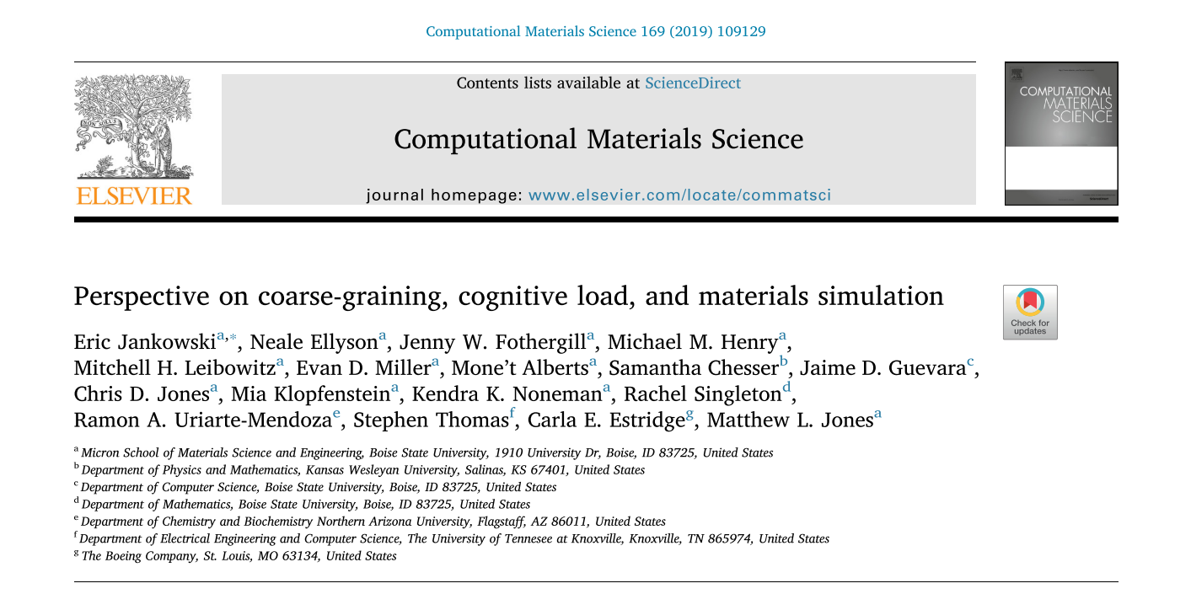

Slide 18
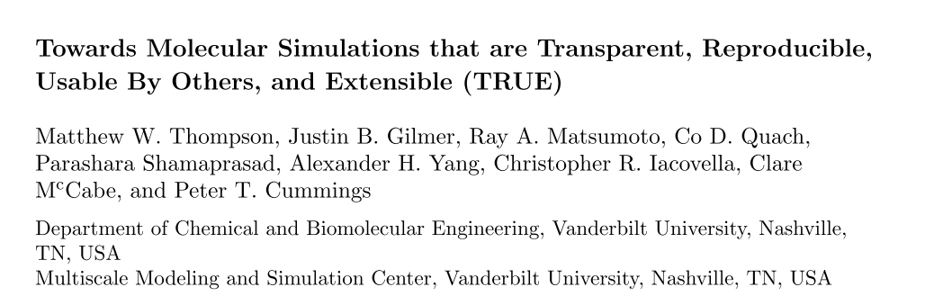
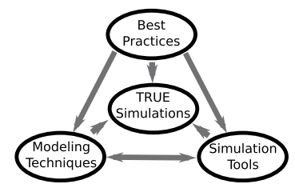
Notes:
﻿lecture by Peter Cummings at the 2019 Thermodynamics conference in Punta Umbra, Huelva, Spain, June 26-28, 2019

Slide 19

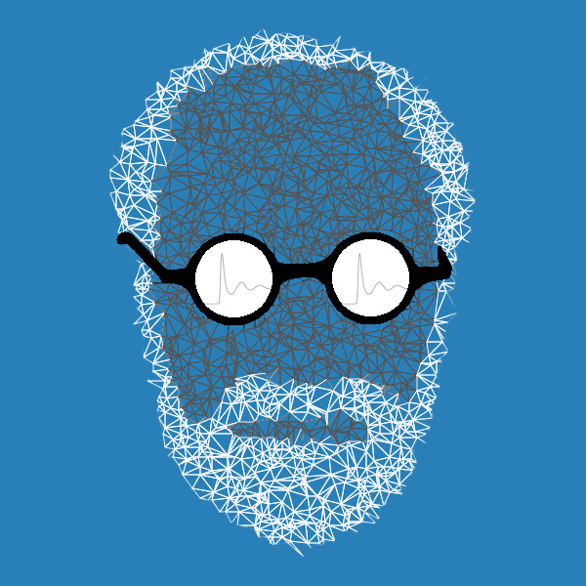

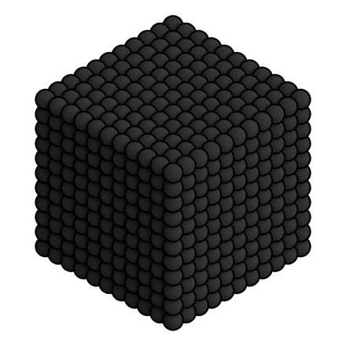

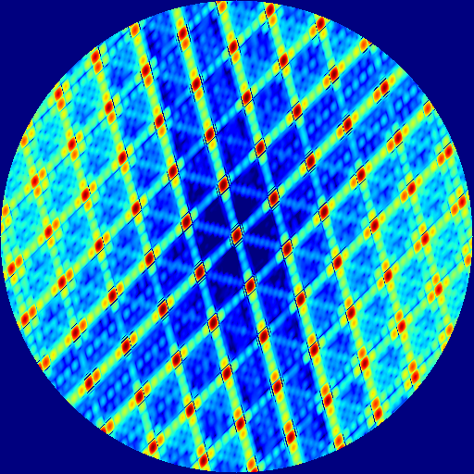

mBuild
gsd
fresnel
GIXStapose

Slide 20
These achieve the same result
hexane_sites = [("_A", "C[CH3]"), ("_B", "CC")]
https://github.com/jennyfothergill/grits
Notes:
GRiTS : Grits Reduce/Restore (i) Topology with SMILES
Versatile Object-oriented Toolkit for Coarse-graining Applications
Simplified Molecular Input Line Entry System

Slide 21
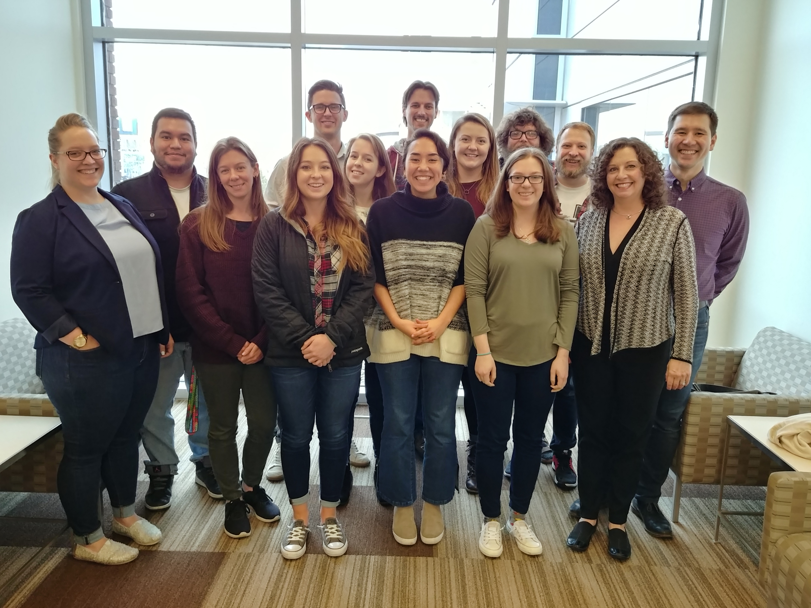
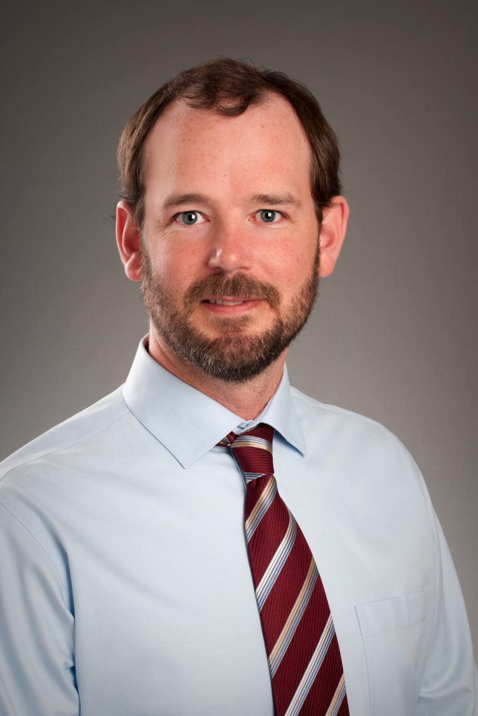
Thank YOU!

Slide 22
Questions?

